Slide 1


Using Time series analysis, Deep Learning and Machine Learning Models
Student Name: Sridhar Guggilla
Student ID: 23021710
Course: MSc Data Science
Supervisor: Hyungrok Kim
Date: 24/11/2025
University of Hertfordshire

Slide 2

1. Project Overview: Forecasting with Precision
This project aimed to predict UK house prices using a diverse set of machine learning and time series models. Our objective was to leverage historical data to generate accurate future forecasts.
Objective
Forecast UK house prices with advanced ML and Time Series models to identify trends.
Dataset
UK House Price Index (1988–2024), providing a robust historical view.
Models Built
ARIMA, SARIMA, LSTM, and Linear Regression for comprehensive analysis.
Evaluation Metrics
RMSE, MAE, and MAPE were used to rigorously assess model performance and accuracy.

Slide 3

2. Dataset & Preprocessing: Preparing for Prediction
Our foundational data consisted of monthly UK house price records, spanning nearly three decades. Meticulous preprocessing was essential to ensure data quality and model efficacy.
Monthly UK house price data: A comprehensive time series from 1988 to 2024, providing a rich historical context for price fluctuations.
Handling missing values: Employed various imputation techniques to ensure data completeness and prevent bias.
Log transformation: Applied to stabilize variance and normalize the distribution, improving model assumptions.
Train-test split strategies: Utilized time-aware splitting to maintain temporal order, crucial for accurate time-series evaluation.

Slide 4
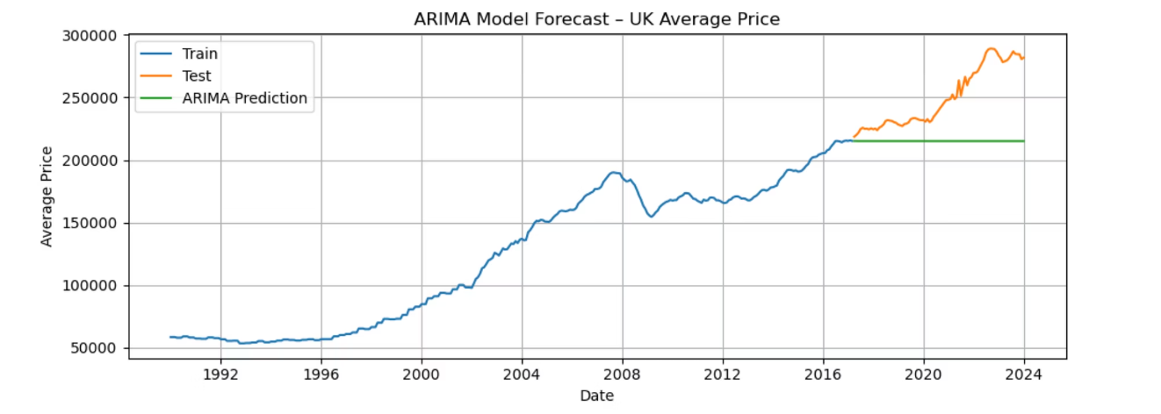
3. ARIMA Model: Autoregressive Integrated Moving Average
The ARIMA model, a cornerstone of time-series analysis, was applied to capture linear relationships and short-term dependencies in the house price data.
Uni-variate time-series forecasting: Focused solely on the historical house price index itself, making it a powerful baseline.
Model Specification: ARIMA(p, d, q): Parameters (p, d, q) were carefully tuned using ACF and PACF plots to optimize performance.
Forecast Horizon: Predictions generated for 12 to 48 months into the future, providing both short and medium-term insights.
Evaluation: Performance rigorously assessed on the unseen test set, focusing on minimizing errors.
Evaluation Metrics for this Model
RMSE – 42043.5
MAE - 34721
MSE - 1767658468
R Square – (-2.1452)

Slide 5
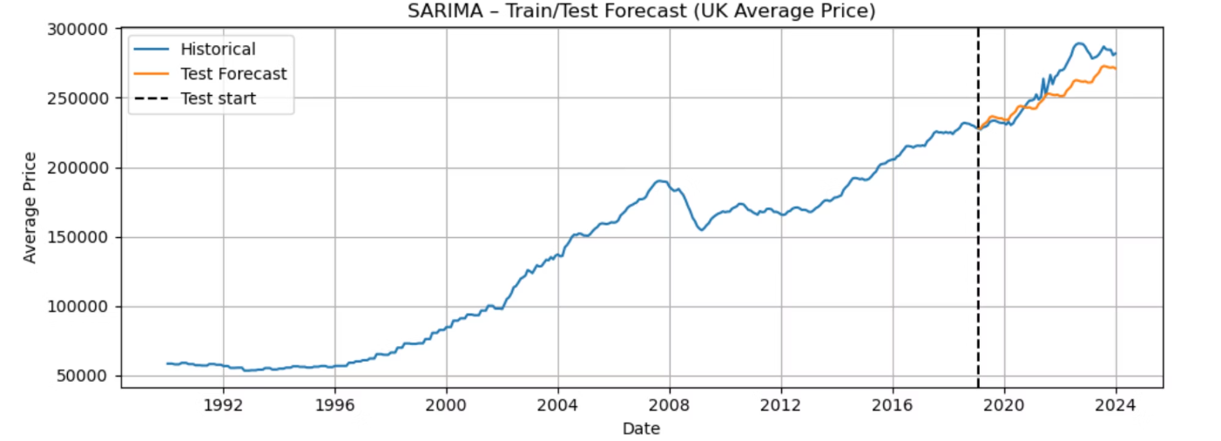
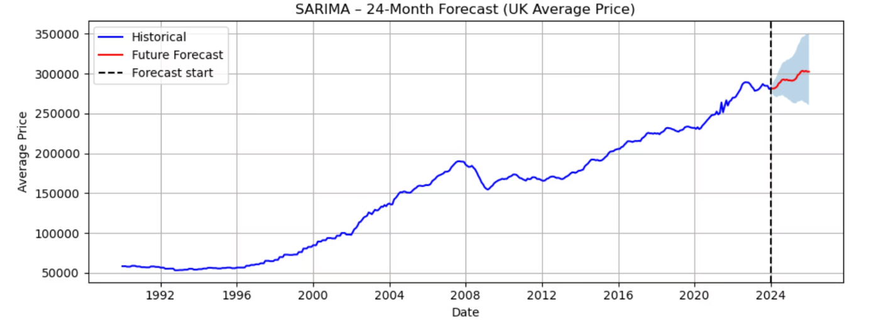
4. SARIMA Model: Enhancing Seasonality
Building upon ARIMA, the Seasonal ARIMA (SARIMA) model was employed to explicitly account for the inherent yearly seasonality often present in housing markets.
Seasonal ARIMA model: An extension of ARIMA, specifically designed to handle time series with seasonal components.
Captures yearly seasonality: Crucial for UK house prices, which often exhibit predictable patterns influenced by annual cycles.
Improved Accuracy: Expected to provide more accurate forecasts by integrating seasonal trends into the predictive framework.
Evaluation Metrics for this Model RMSE – 13274, MAE - 10538

Slide 6
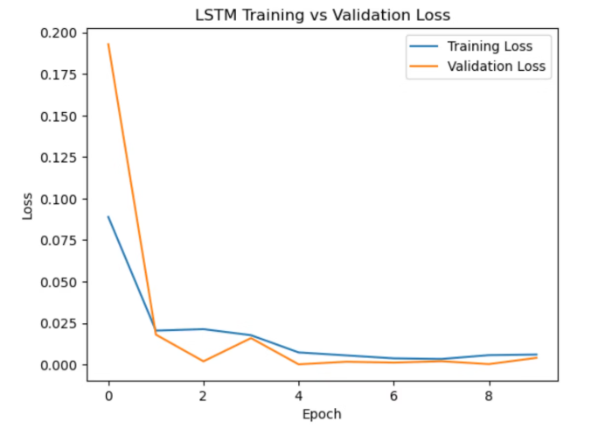
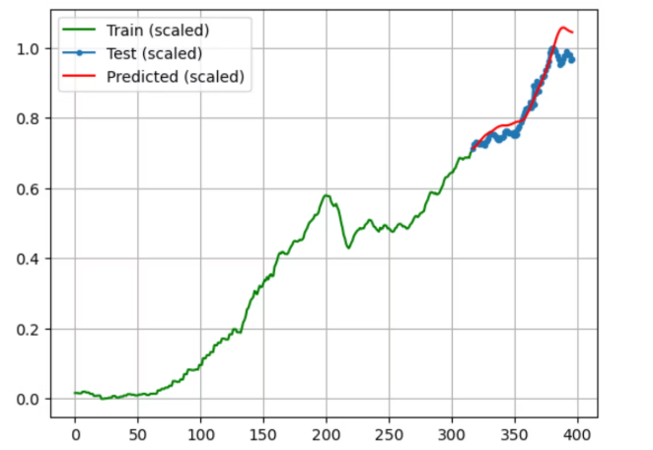
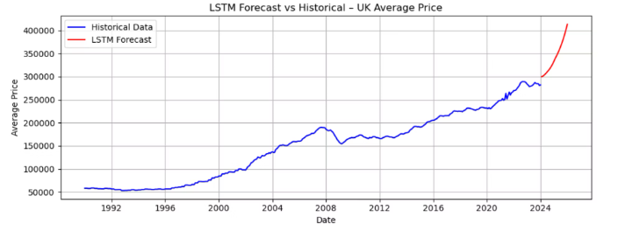
5. LSTM Model: Deep Learning for Time Series
Long Short-Term Memory (LSTM) networks, a sophisticated type of Recurrent Neural Network (RNN), were deployed to capture complex, non-linear patterns and long-term dependencies inherent in historical house price series. This deep learning approach is particularly effective for sequential data forecasting, where past observations heavily influence future values, making it highly suitable for house price prediction.
Loss drops sharply within the first few epochs, showing fast learning.
The predicted values align tightly with actual test data.
LSTM extends the historical trend realistically without sudden jumps.
The model captures long-term growth and short-term fluctuations accurately.
Training and validation curves converge closely → no overfitting.
Forecast shows continued price growth, consistent with long-term UK market behaviour.
No drift or instability → high predictive accuracy and consistency.
Near-zero loss values indicate strong pattern learning and stable generalization.
The model successfully learns both macro trends and local variations.
Evaluation Metrics RMSE – 8691, MSE – 7555055, R Squared – 0.86

Slide 7
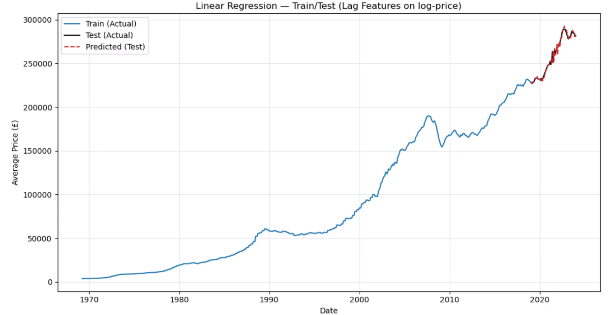
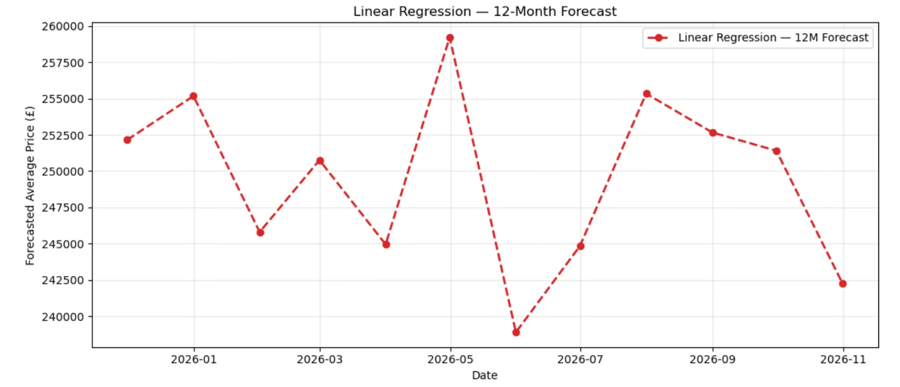
6. Linear Regression Model: Simplicity with Strength
Despite its simplicity, a Linear Regression model, augmented with engineered lag features, emerged as a strong contender, offering stable and reliable predictions.
Created lag features: Past values of house prices were incorporated as features, enabling the model to learn from historical trends.
Model performed better: Surprisingly, this simpler model outperformed ARIMA, SARIMA, and even LSTM in certain evaluation metrics, highlighting the power of feature engineering.
Most stable predictions: Demonstrated remarkable consistency and less volatility in its forecasts, making it a highly reliable option for long-term planning.
Evaluation Metrics RMSE – 3295 MAPE – 0.85% MAE – 2232

Slide 8




7. Conclusion & Future Work
Our analysis revealed that a well-engineered Linear Regression model can outperform more complex time-series and deep learning approaches for UK house price prediction. However, opportunities for further enhancement abound.
LR Most Accurate
Time-Series Performance
Linear Regression proved to be the most accurate model for this dataset.
SARIMA models performed reasonably well, providing valuable insights.
Future Work
Focus on advanced feature engineering, regional models, and hybrid approaches.

